Slide 1
Structure of different model
Kinetics Rates Prediction
”so-called” experiment
model training procedure
model training procedure
Pathway
mechanism
-guided
Black Box
approach
get recommendation combinations of enzymes
get recommendation combinations of enzymes
experiment the recommendations and get Limonene concentrations
experiment the recommendations and get Limonene concentrations

Slide 2
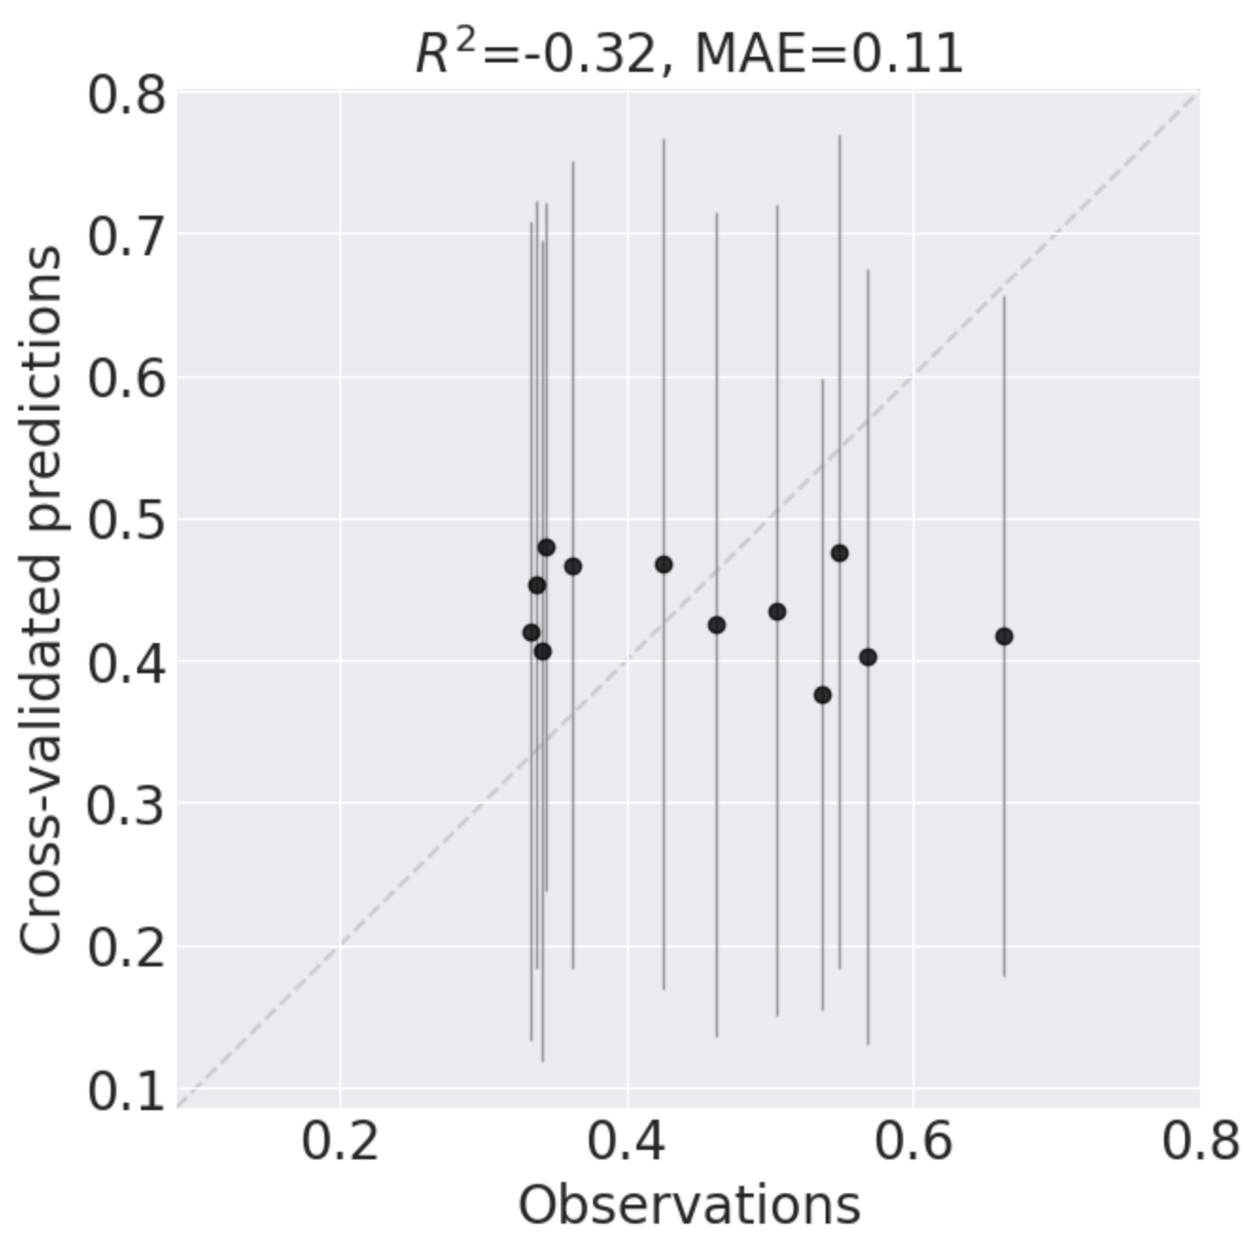
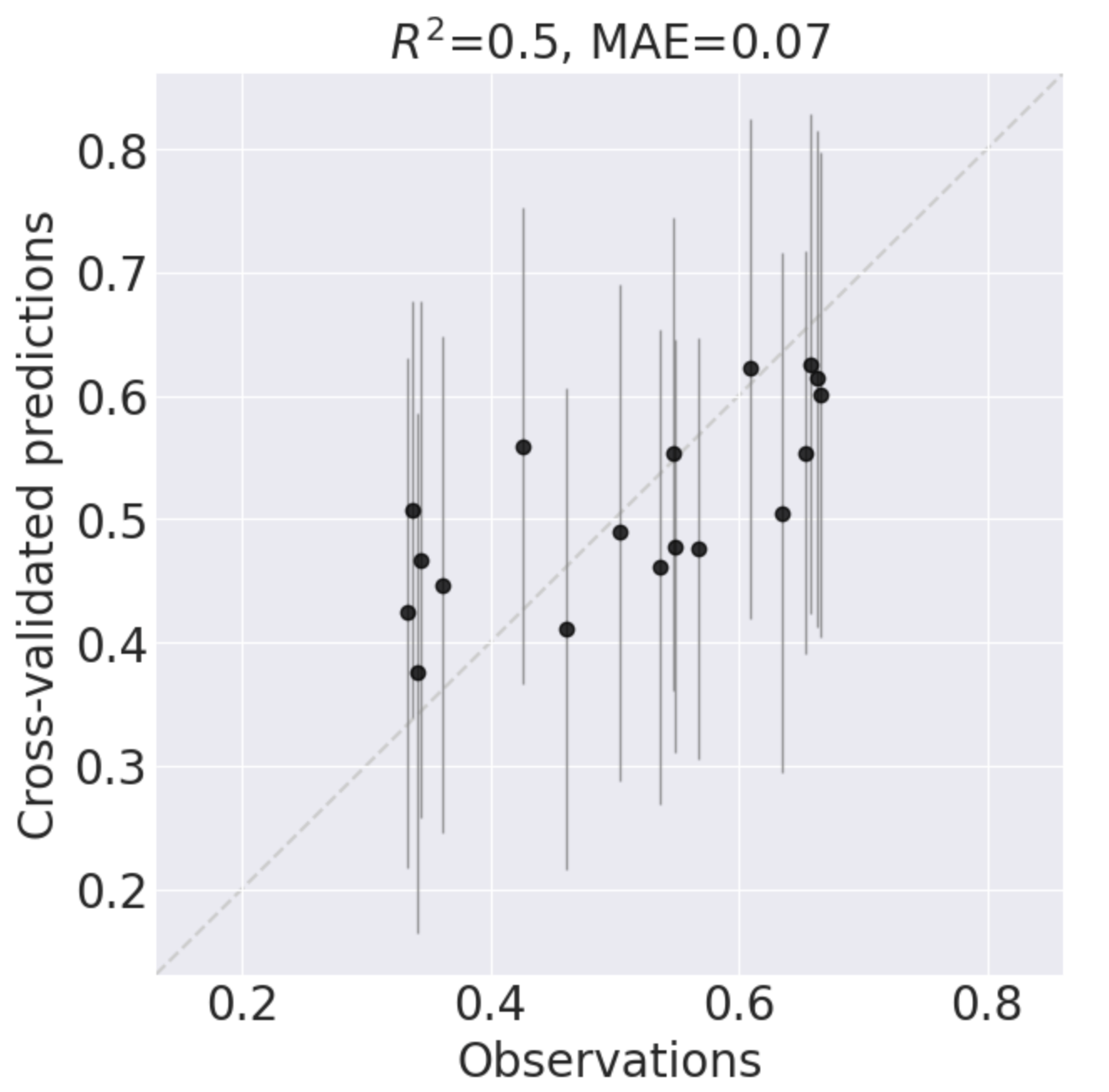
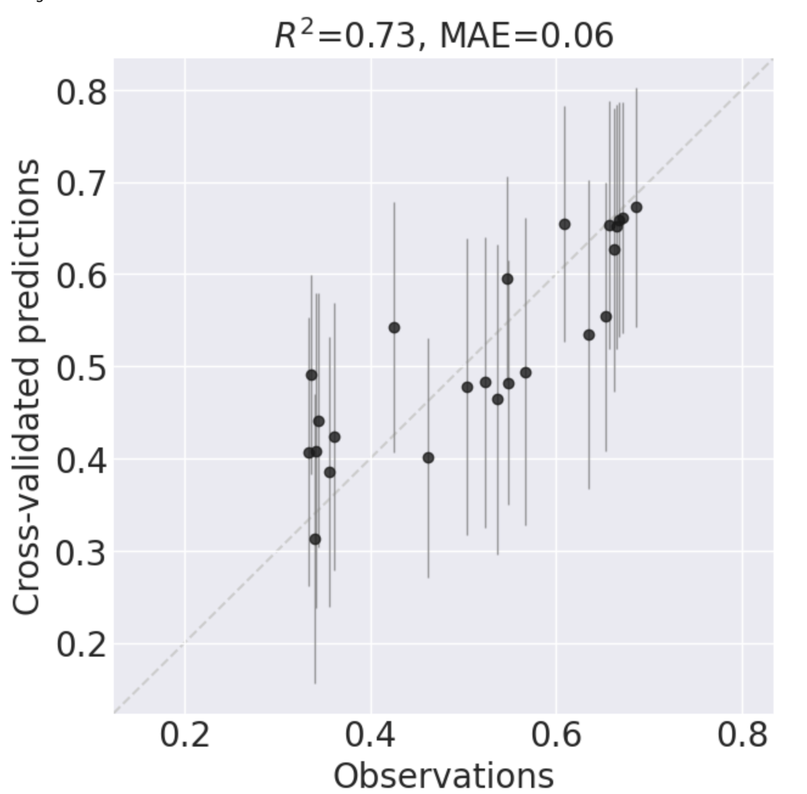
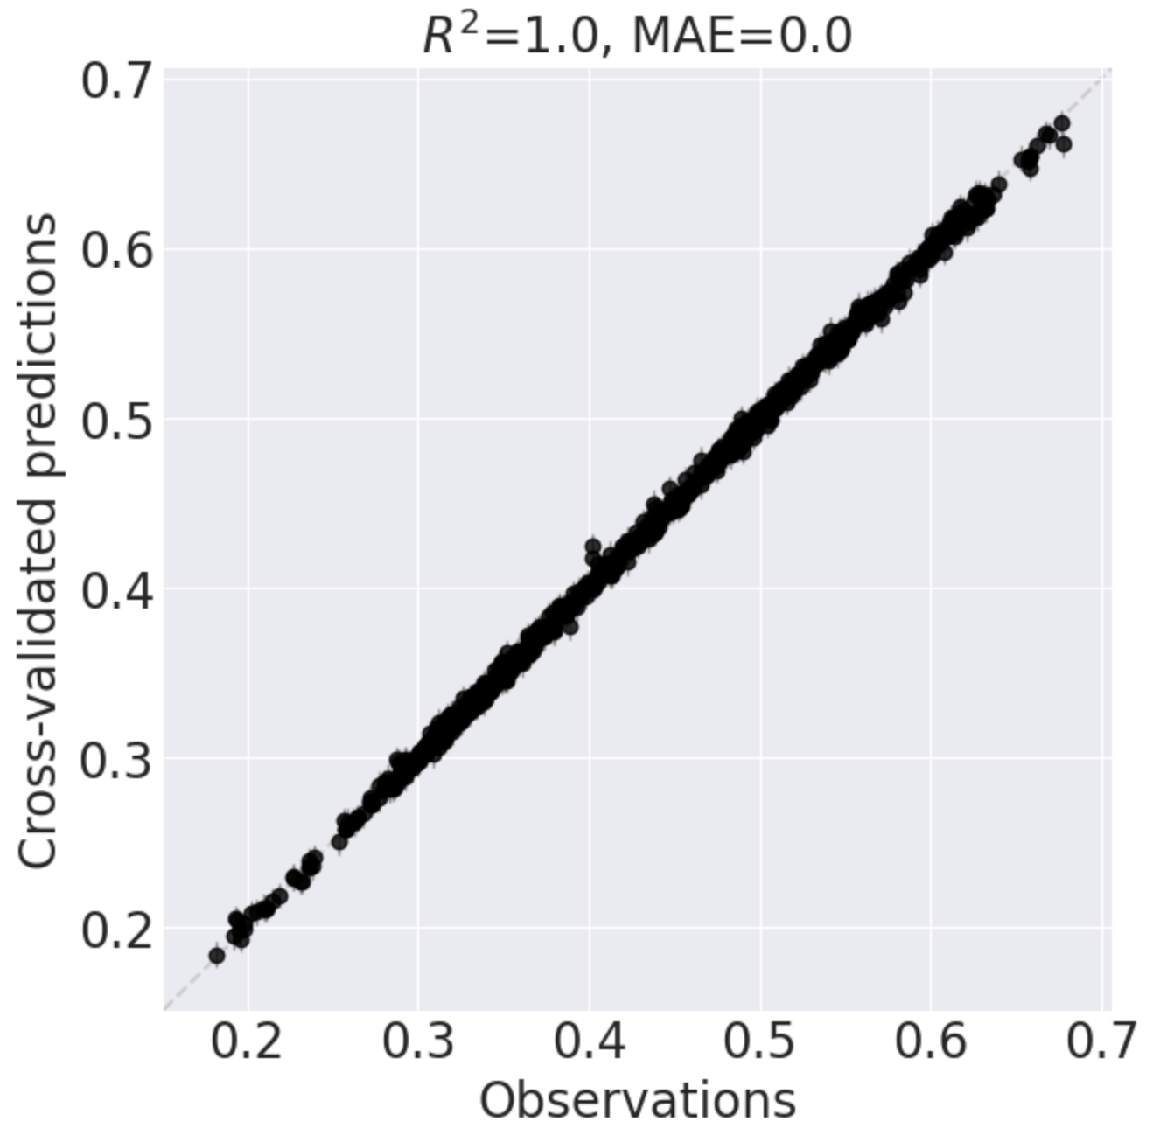
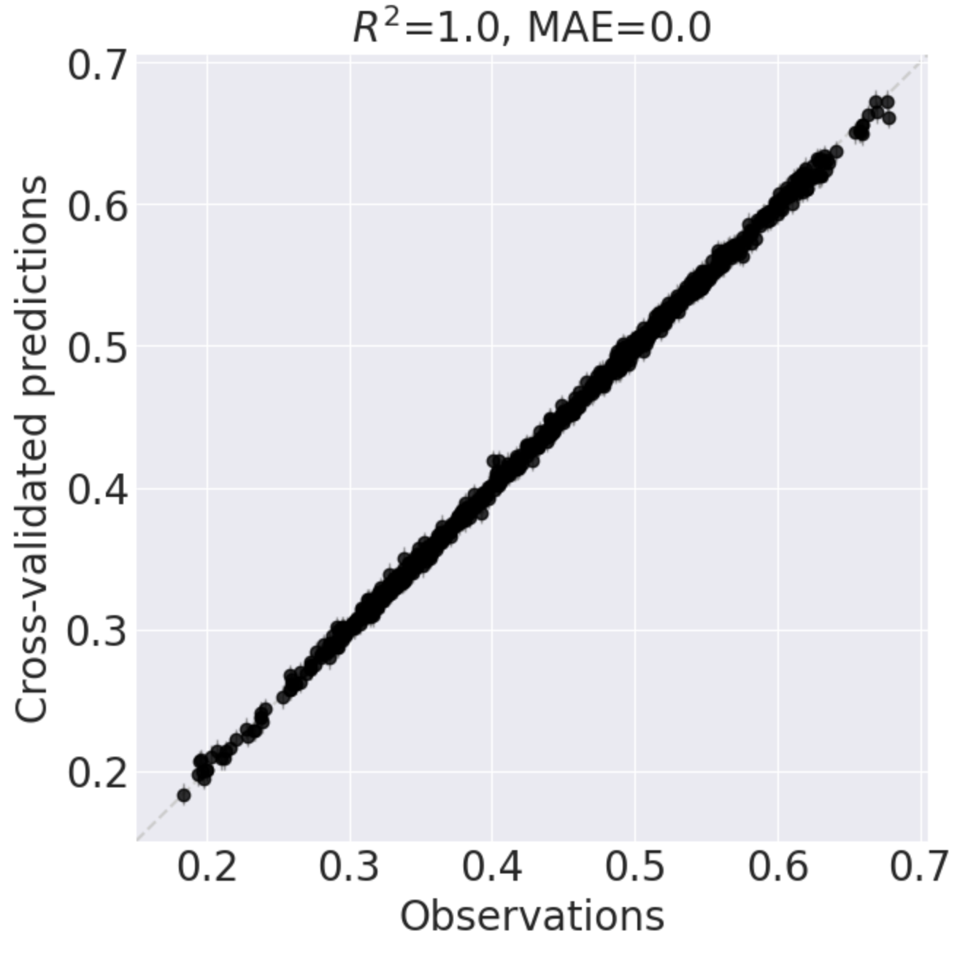
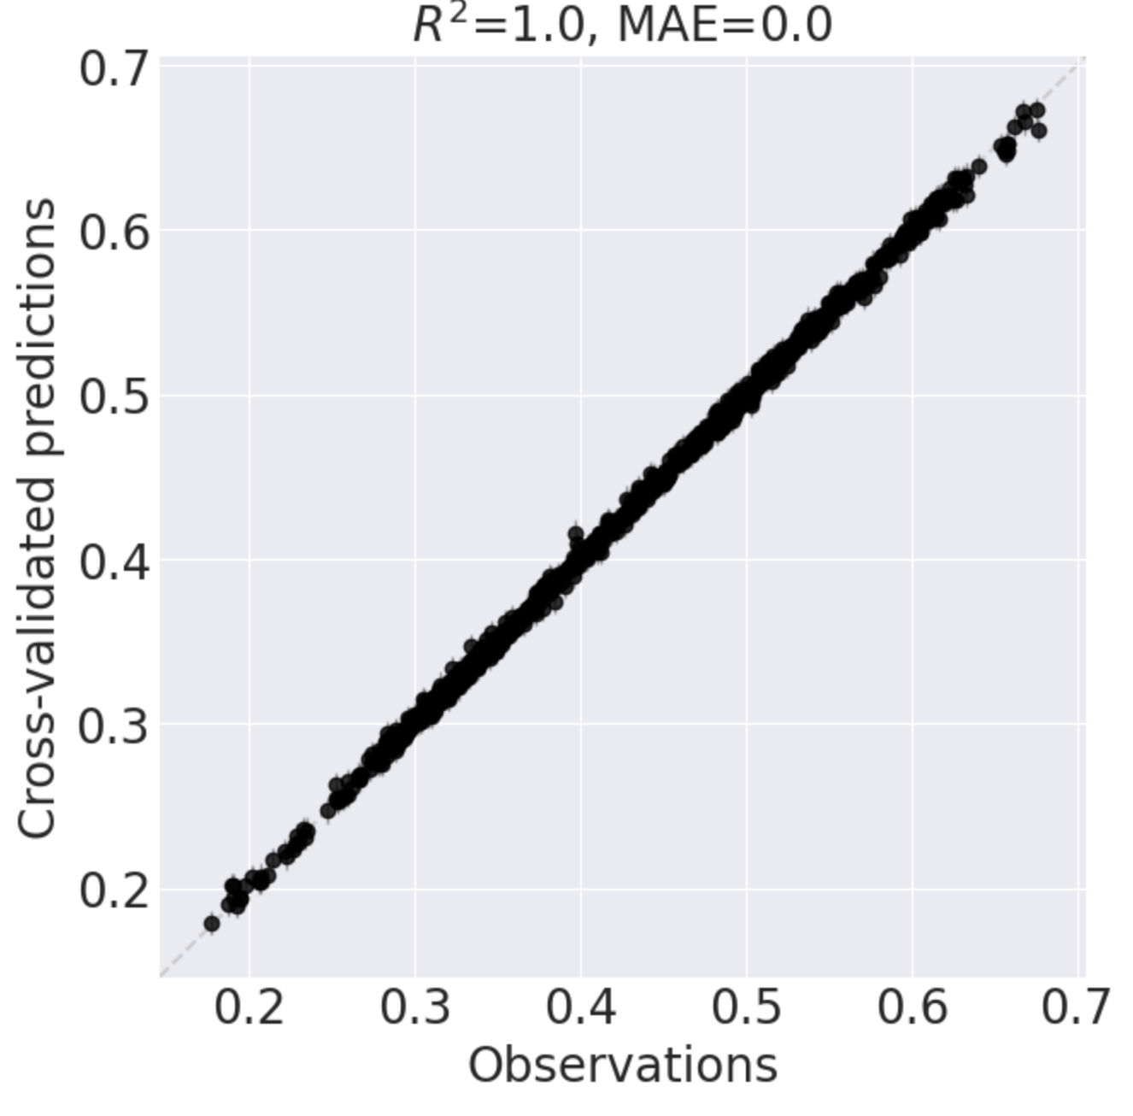
Quality of built model
1st model
using 12 samples
2nd model
using 12+6 samples
3rd model
using 12+6+6 samples
Black Box
approach
1st model
using 4 samples
2nd model
using 4+6 samples
3rd model
using 4+6+6 samples
Pathway
mechanism
-guided

Slide 3
Recommendations
1st model
using 12 samples
2nd model
using 12+6 samples
3rd model
using 12+6+6 samples
Black Box
approach
exploitation
1st model
using 4 samples
2nd model
using 4+6 samples
3rd model
using 4+6+6 samples
exploration
Pathway
mechanism
-guided
Highly similar

Slide 4
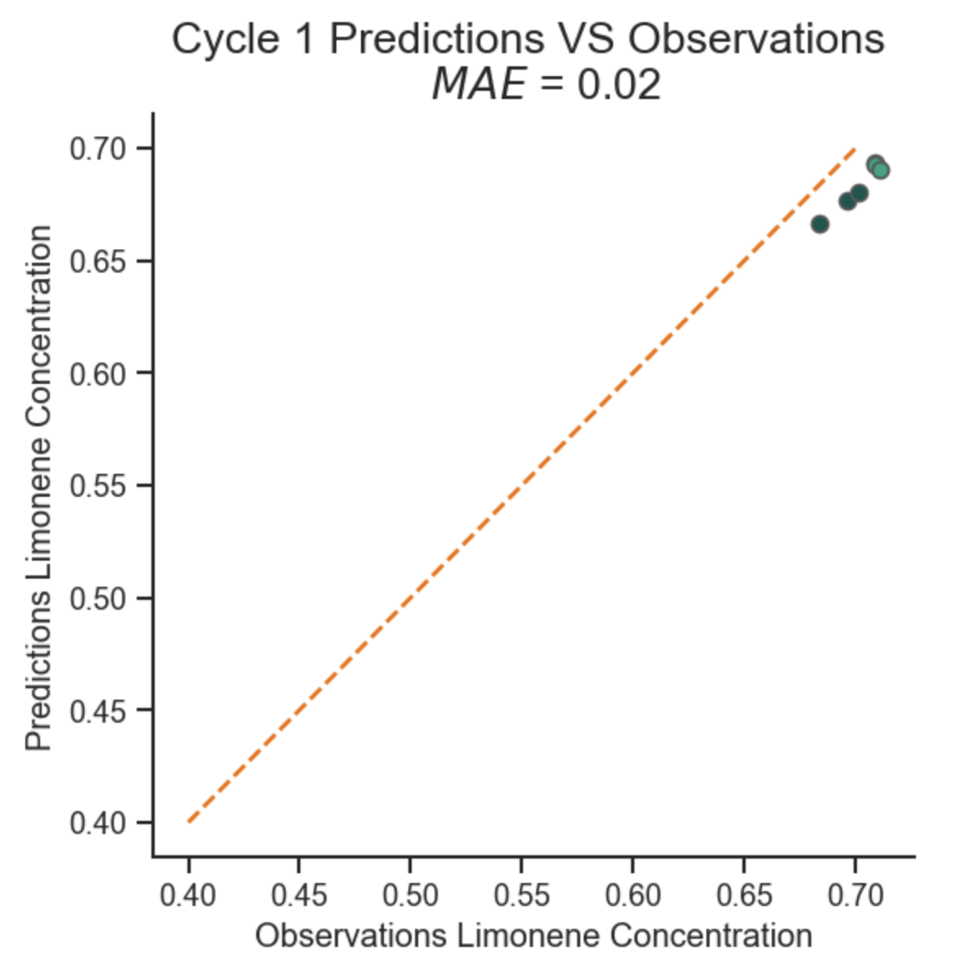
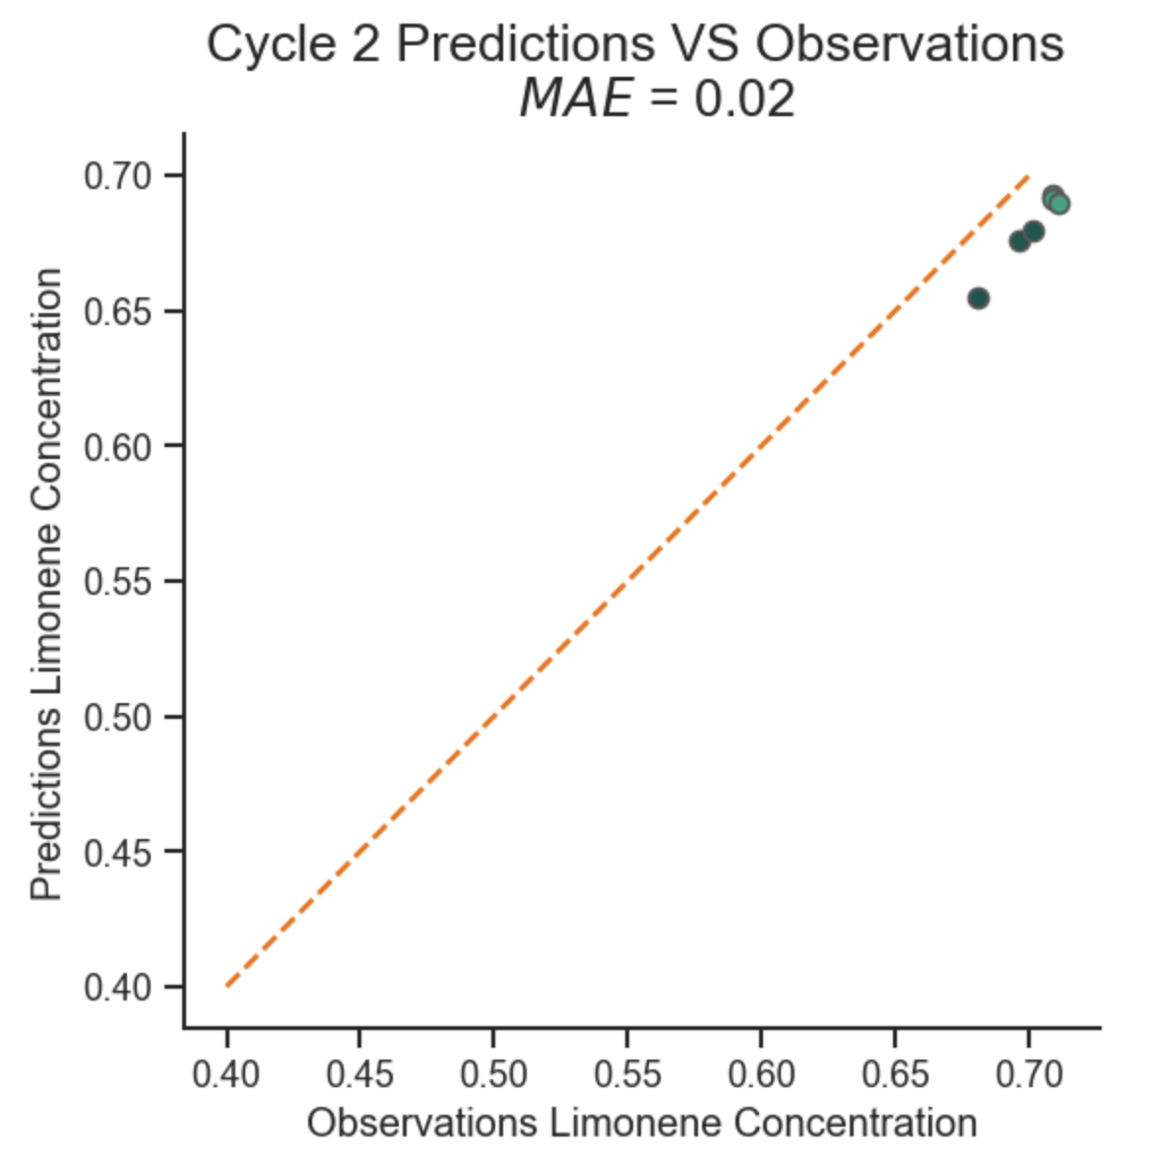
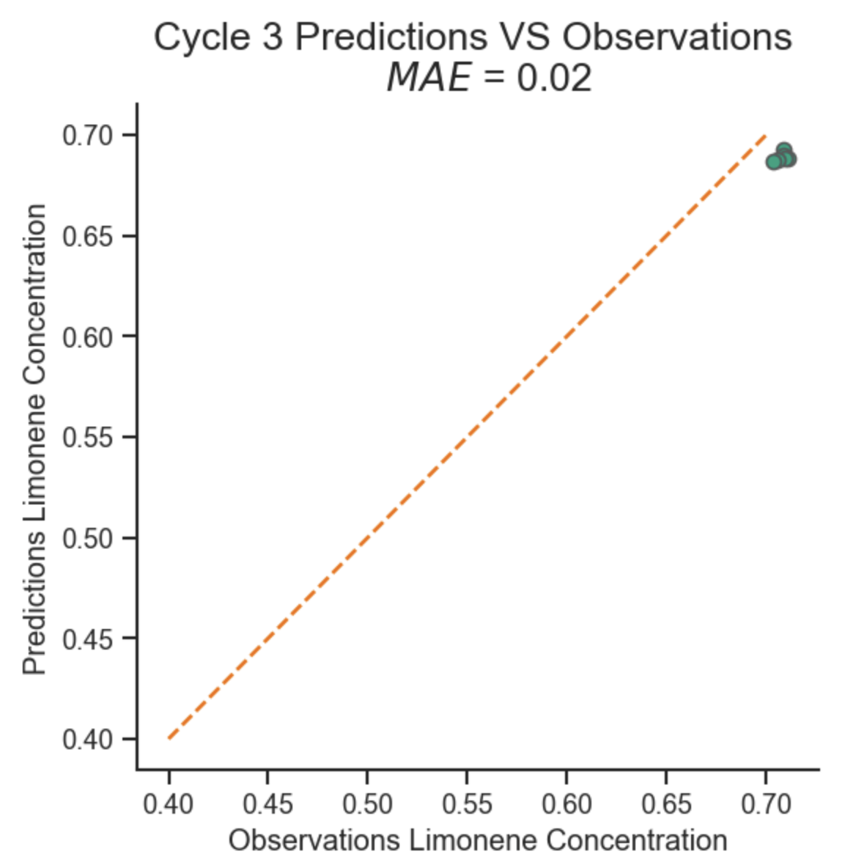
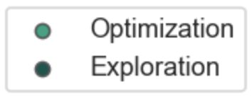
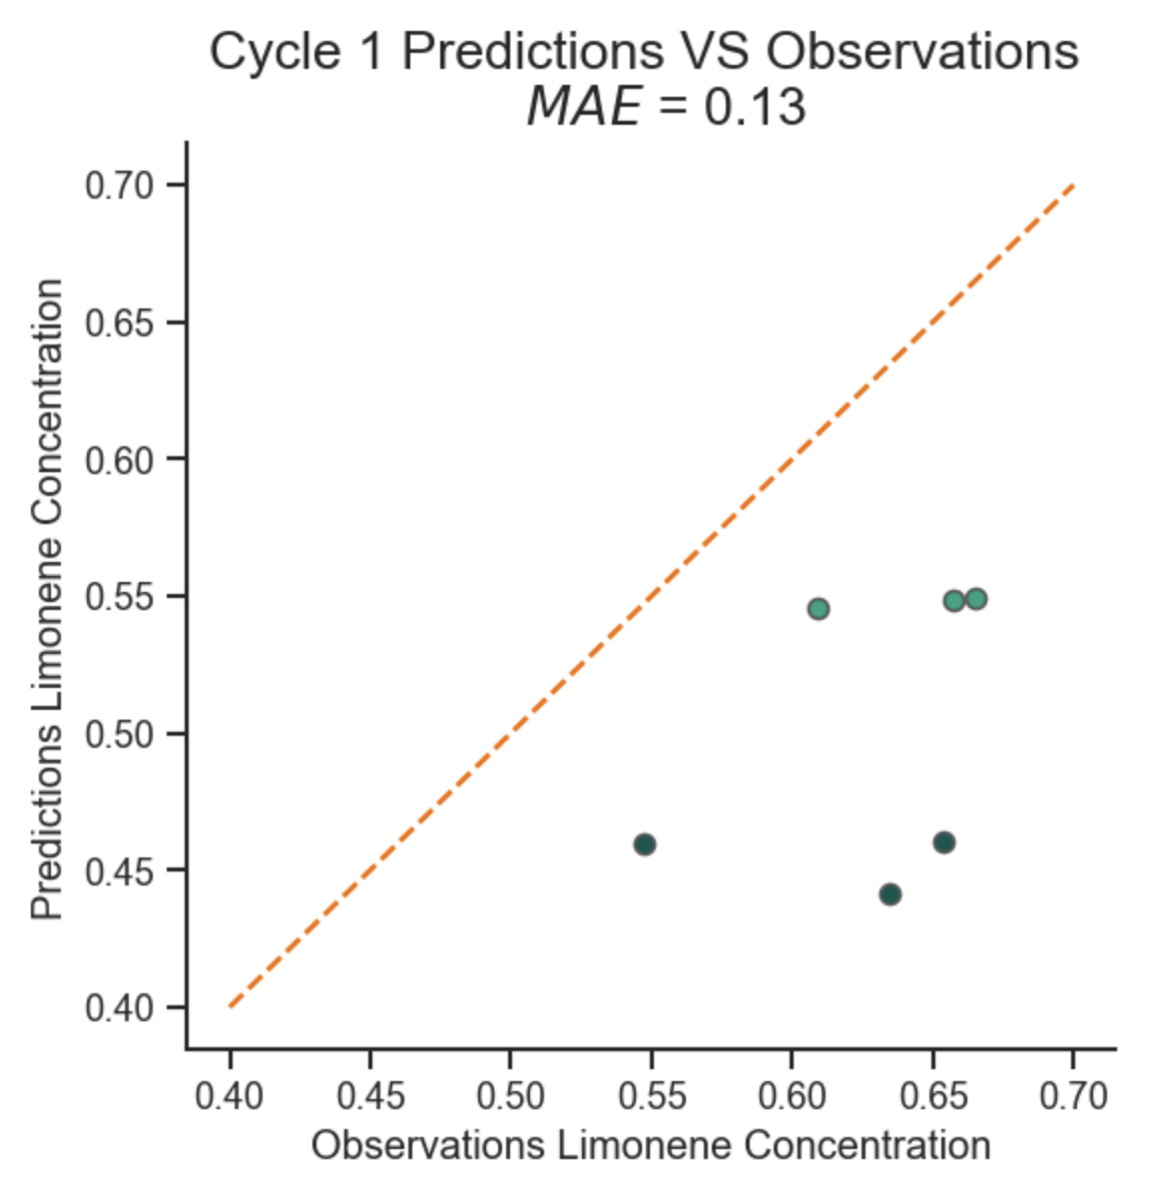
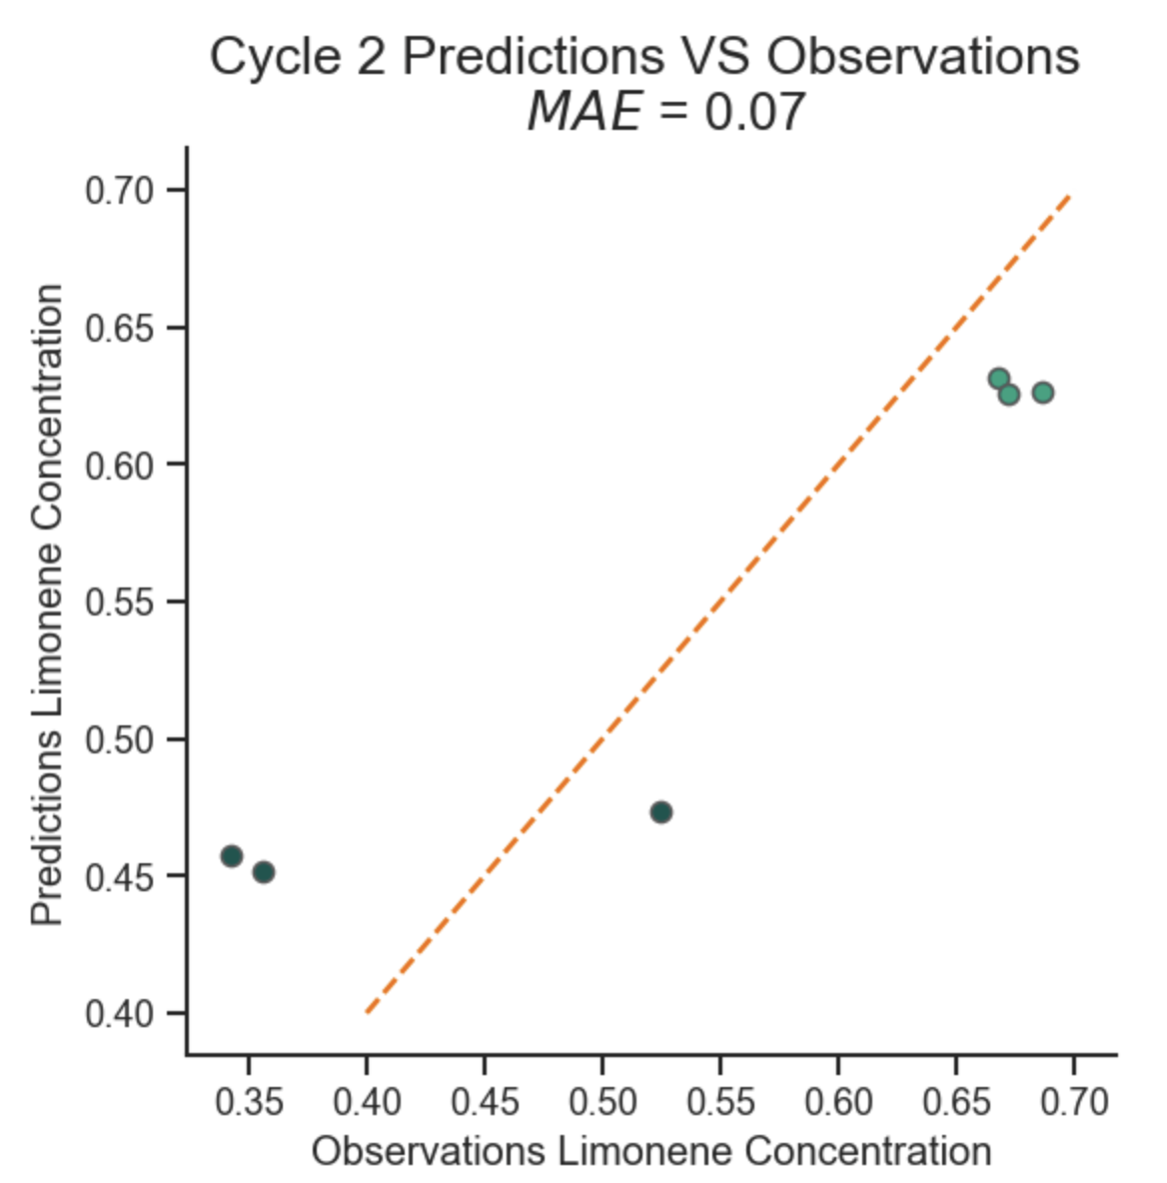
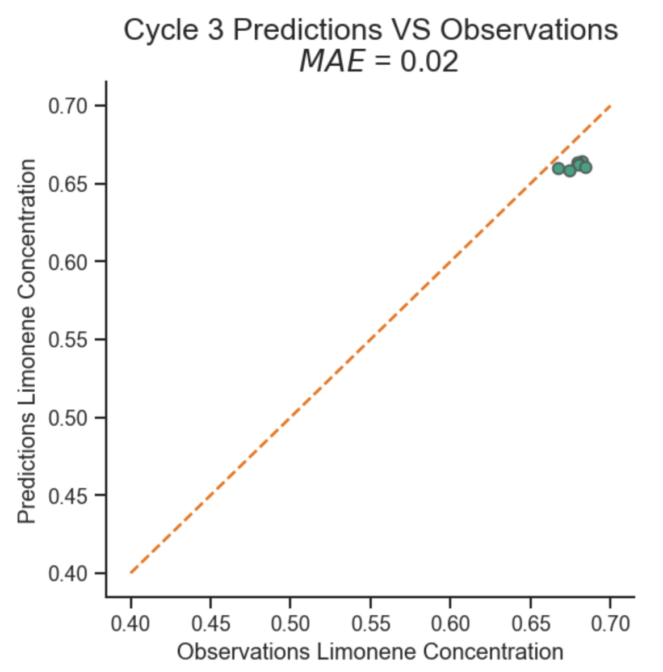
Quality of predictions
1st model
using 12 samples
2nd model
using 12+6 samples
3rd model
using 12+6+6 samples
Black Box
approach
1st model
using 4 samples
2nd model
using 4+6 samples
3rd model
using 4+6+6 samples
Pathway
mechanism
-guided

Slide 5
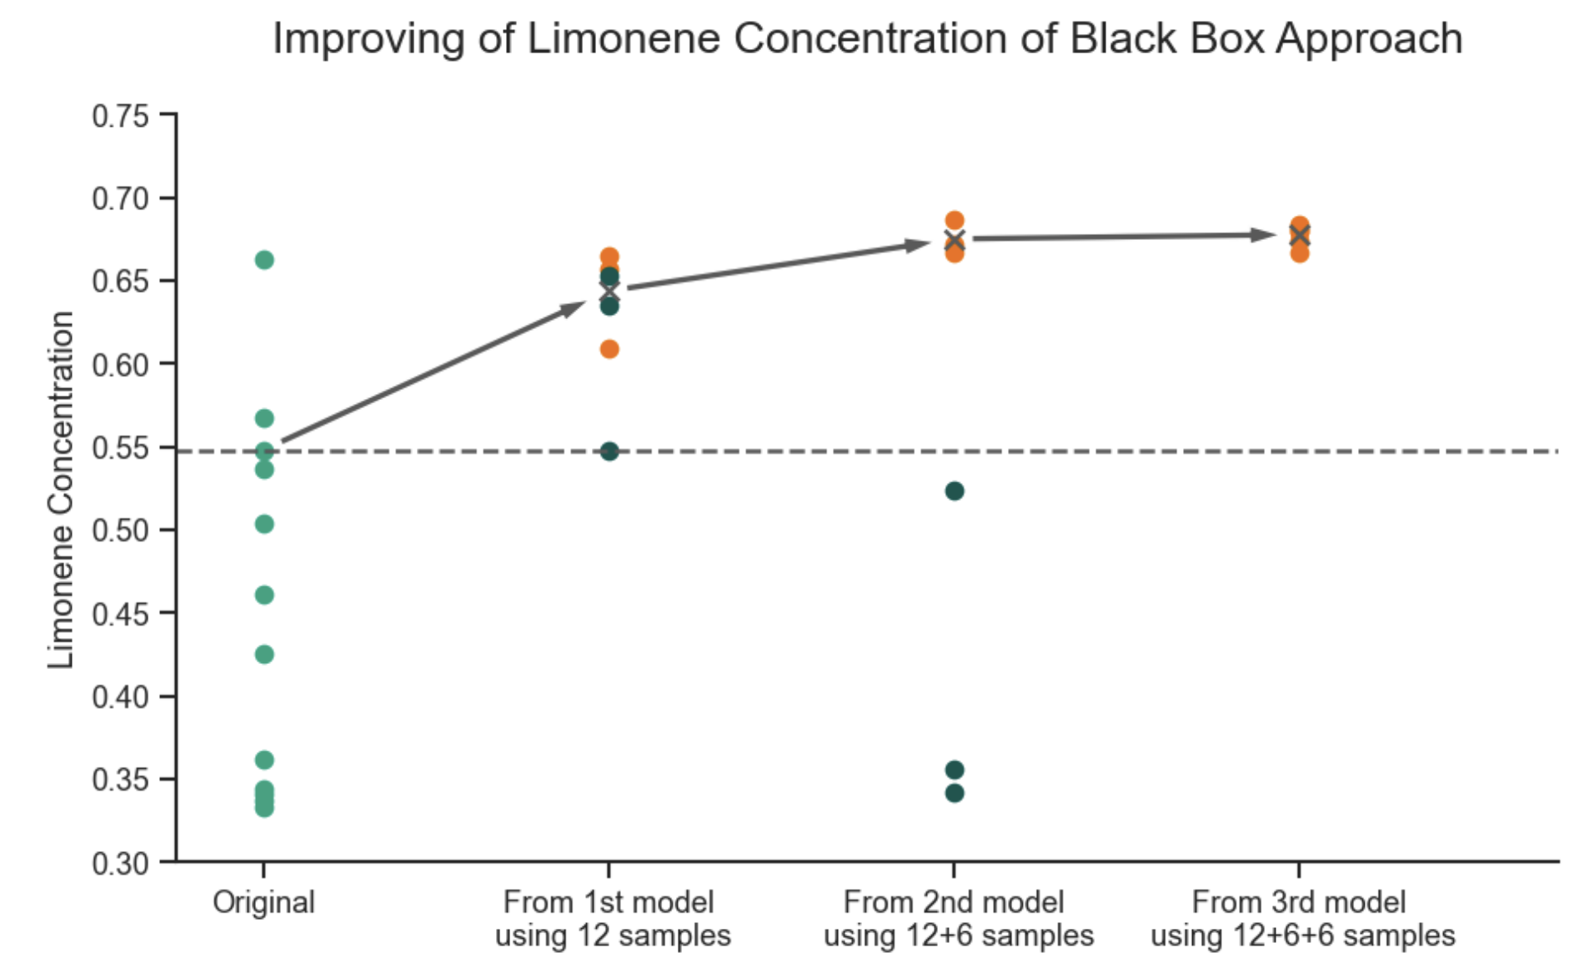
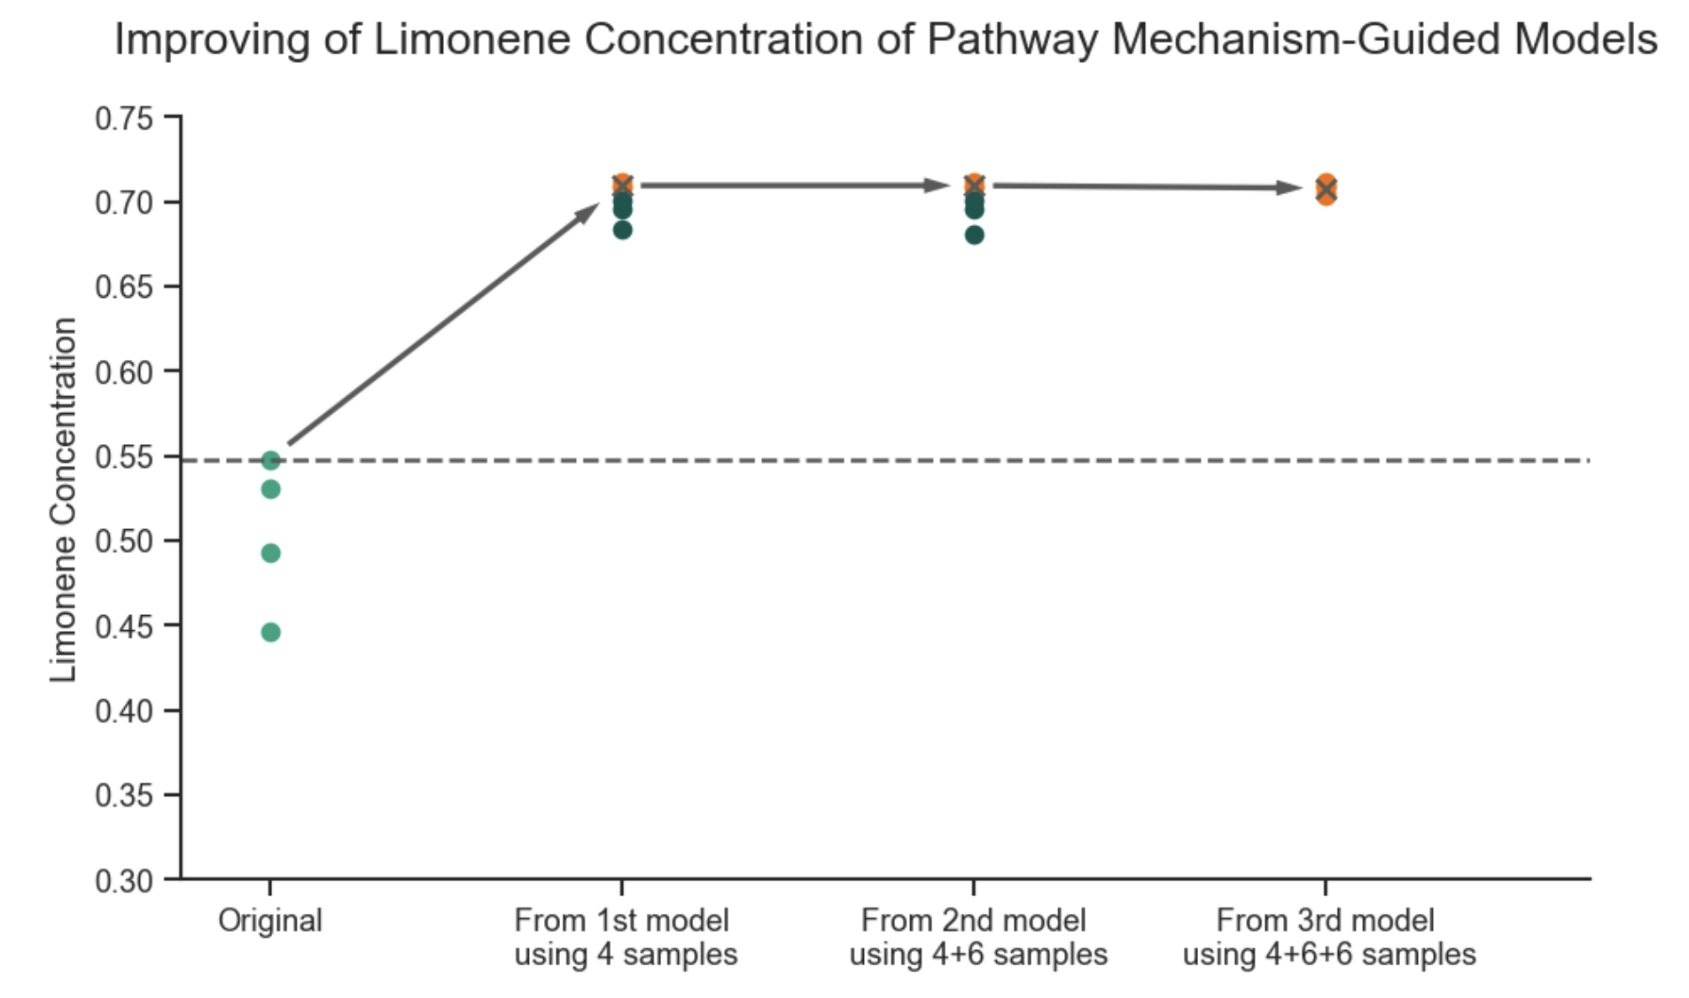
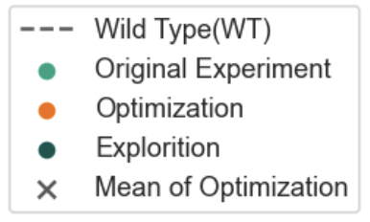
Effectiveness of yield improvement
Pathway
mechanism
-guided
Black Box
approach

